Slide 1
Module-1:
BASICS OF C PROGRAMMING

Slide 2
Module-1: BASICS OF C PROGRAMMING :
Introduction to programming paradigms: Applications of C Language, Structure of C program
C programming: Data Types, Constants, Enumeration Constants, Keywords.
Operators: Precedence and Associativity, Expressions, Input/Output statements, Assignment statements, Decision making statements, Switch statement, Looping statements Preprocessor directives, Compilation process.

Slide 3
What is Programming?
What is Programming Language?

Slide 4
What is Programming? : Writing a Program
What is Programming Language? : Is a Collection of Tokens.

Slide 5
C Tokens:
In C, tokens are the smallest units in a program that have meaningful representation. They are the building blocks of the language.
There are several types of tokens in C, which are categorized as follows:
Types of C Tokens
Keywords
Identifiers
Constants
String Literals
Operators
Punctuation (Separators)

Slide 6
1. Keywords
Keywords are reserved words in C that have special meaning and cannot be used as identifiers (variable names, function names, etc.). Each keyword in C has a specific meaning and purpose in the program.
Examples of keywords: int, return, if, while, for, switch, void, break, continue, struct
Explanation:
int: Declares integer variables.
return: Exits from a function and optionally returns a value.
if, else: Conditional statements.
2. Identifiers
Identifiers are the names given to various program elements like variables, functions, arrays, and structures. An identifier must begin with a letter (a-z, A-Z) or an underscore (_), followed by letters, digits (0-9), or underscores.
Examples of identifiers: num, sum, average, totalAmount
Explanation:
Identifiers help in distinguishing different entities in a program.
They should not match any of the keywords.

Slide 7
3. Constants:
Constants represent fixed values in a program, which doesn’t change thought the life cycle of the Program
1. Integer Constants: These are whole numbers without decimals.
Example: 10, -5, 0
2. Floating-point Constants: These represent real numbers with decimals.
Example: 3.14, -0.5, 2.0
3. Character Constants: These represent single characters enclosed in single quotes.
Example: 'A', '1', ‘%’
4. String Constants: These represent a sequence of characters enclosed in double quotes.
Example: "Hello, World!"
Explanation:
Constants represent values that remain unchanged during program execution.
The type of the constant is determined by its form, such as integer, floating-point, or character.

Slide 8
4. Literals:
In C, literals refer to fixed values that are directly used in a program. They represent constant values used in the program and can be of various types. Example Values assigned to a variable int a =10;
The literal types in C include:
Integer Literals
Floating-point Literals
Character Literals
String Literals
Boolean Literals (C99 and later)
Void Pointer Literals (C99 and later)

Slide 9
5. Operators:
In C, operators are symbols used to perform operations on variables and values. Operators can be classified based on the number of operands they operate on. The main classifications are Unary, Binary, and Ternary operators.
Operators are symbols that perform operations on variables and values.
Example: +, -, *, =, ==, +=, --, ++ and so on.
6. Punctuation (Separators):
Punctuation marks (also called separators) are symbols used to separate different parts of a program, such as statements, declarations, and arguments.
Example: {}, [], (), ., /, :, and so on.

Slide 10
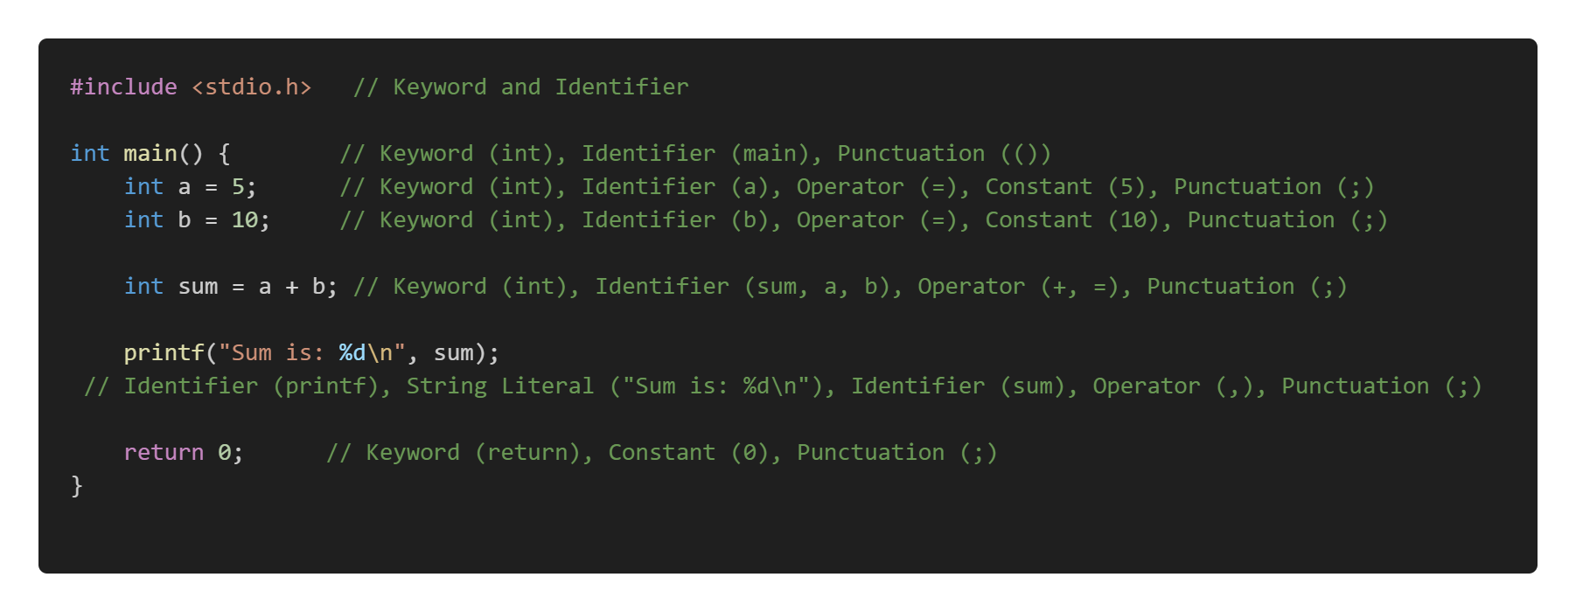
Example:

Slide 11
Programming Paradigms (Models):
Programming paradigms are foundational styles or approaches to programming that provide a way to structure and organize code. They define how problems are formulated and solved in programming.
Imperative Programming: Focuses on how a program operates.
Examples: C, Python (imperative style), Java.
Declarative Programming: Focuses on what the program should accomplish rather than how it is achieved.
Examples: SQL, HTML, Prolog.
Procedural Programming (How to Do): A subset of imperative programming that organizes code into reusable procedures or functions.
Examples: C, Pascal.
Functional Programming (What to Do): Treats computation as the evaluation of mathematical functions, avoiding changing state and mutable data.
Object-Oriented Programming (OOP): Models real-world entities using objects and classes. Examples: Java, C++, Python (OOP style).

Slide 12
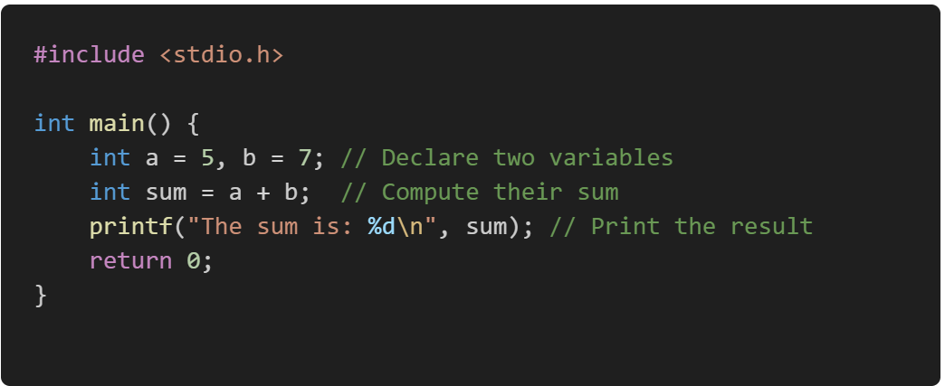
1. Imperative Programming:
Here we need to specify the exact sequence of steps or instructions that the computer must follow to achieve a desired result.
In an imperative programming style, the programmer provides detailed instructions to the computer, including how data is processed, modified, and stored.
Here is an example of summing the numbers from 1 to 5 imperatively:

Slide 13

2. Declarative Programming:
In declarative programming, you state what the program should do and let the underlying system handle how to achieve it.
Example in SQL:

Slide 14
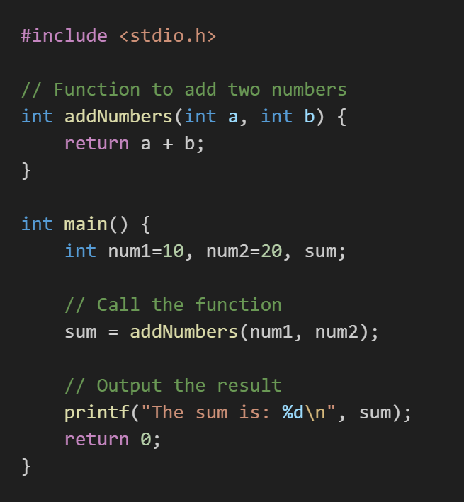
3. Procedural Programming :
Procedural programming is a programming paradigm derived from imperative programming that emphasizes breaking down a program into procedures or functions.
These procedures are reusable blocks of code that perform a specific task. Procedural programming focuses on a sequence of instructions executed in a defined order to achieve a specific outcome.

Slide 15
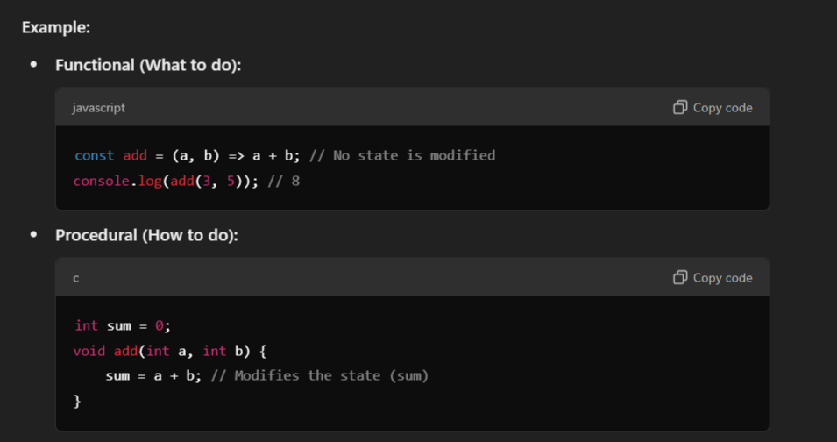
4. Functional programming (What to Do) :
Functional programming is a programming paradigm where computation is treated as the evaluation of mathematical functions, avoiding changing state and mutable data. It emphasizes what to do rather than how to do it, focusing on the use of pure functions, immutability, and function composition.

Slide 16
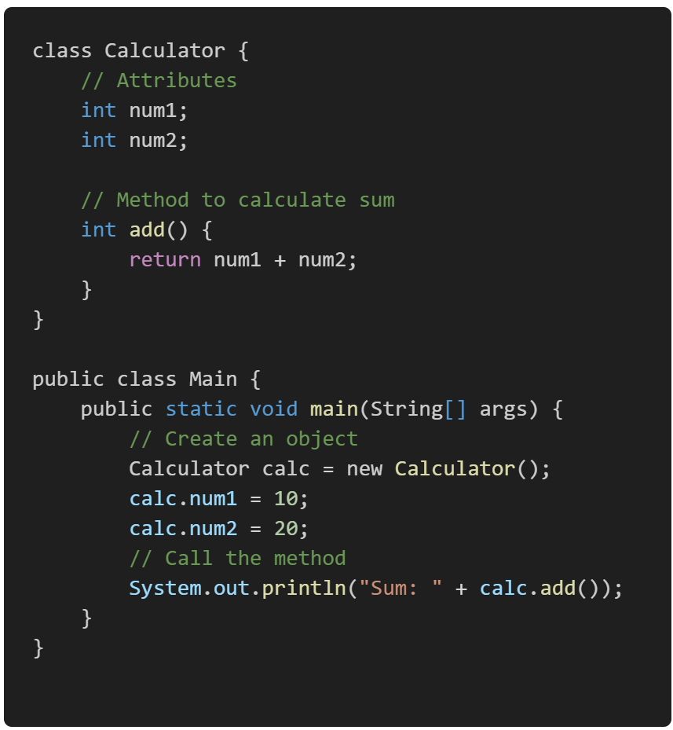
5. Object-Oriented Programming (OOP)?
Object-Oriented Programming (OOP) is a programming paradigm based on the concept of objects, which are instances of classes.
These objects encapsulate data (attributes) and behavior (methods), allowing for modular, reusable, and maintainable code.
OOP promotes the organization of code into real-world entities, making it easier to design complex systems.

Slide 17
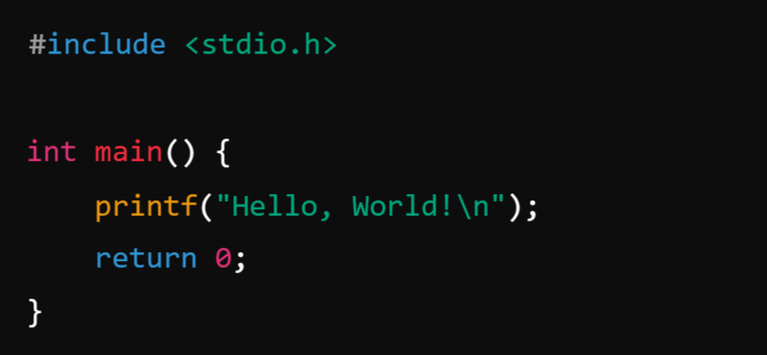
What is C Programming?
C is a procedural programming language that was developed by Dennis Ritchie in the early 1970s at Bell Labs. It has had a profound influence on many programming languages and is still widely used today, especially in system programming, embedded systems, and operating systems development.
Here’s a simple C program that prints "Hello, World!" to the console:

Slide 18
What is Procedure?
A procedure in programming refers to a set of instructions or a block of code designed to perform a specific task or operation. Procedures are typically used to encapsulate functionality that can be reused in different parts of a program. In some programming languages, procedures are also called functions, methods, or subroutines.
Note:
No Return Value (in some languages): In some contexts, procedures do not return any value, unlike functions that usually return a result. Procedures are simply called to perform an action.
Encapsulation: A procedure encapsulates a specific set of instructions that perform a defined task. It allows you to avoid repeating the same code and makes your program more modular and organized
Parameters (Optional): A procedure can take input parameters, which allow you to pass data to the procedure. These parameters help the procedure perform its task dynamically based on the input.
Reusability: Once a procedure is defined, you can call it as many times as needed without rewriting the code.

Slide 19
Types of Procedures:
1. Void Procedure (No Return Value):
A Void Procedure is a procedure that performs an operation but does not return any value. It may perform an action like printing a result or modifying some data.
Example: Add Two Numbers and Print the Result (Void Procedure)
2. Function Procedure (Returns a Value)
A Function Procedure is a procedure that returns a value after performing its task. The value could be any type, such as an integer, float, string, etc.
Example: Add Two Numbers and Return the Result (Function Procedure)

Slide 20
Structure of C program:
The structure of a C program generally follows a specific order of components to ensure proper execution and clarity. Here's an outline of the basic structure:
Basic Structure of a C Program:
Preprocessor Directives
Global Declarations
Main Function
Function Declarations and Definitions

Slide 21
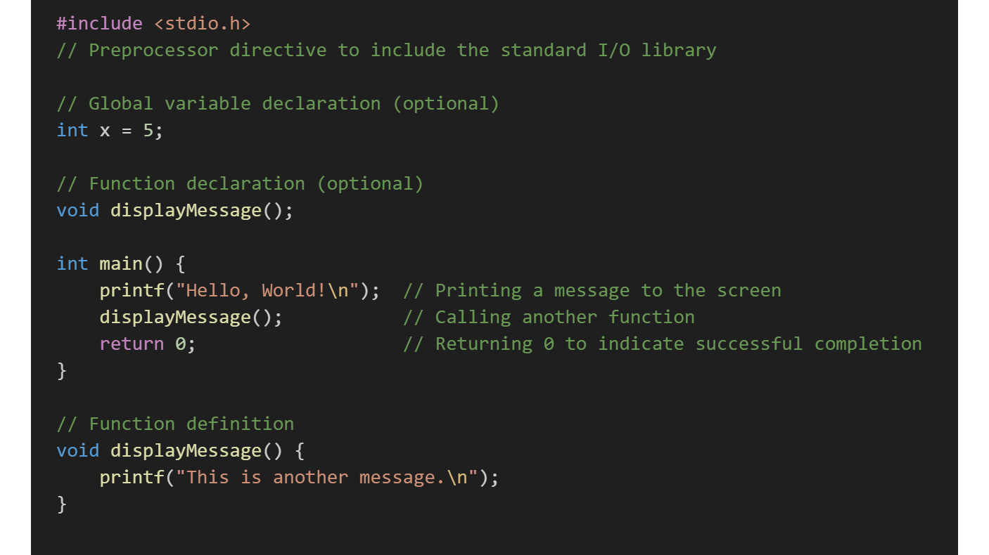
Example: Structure of C Program

Slide 22
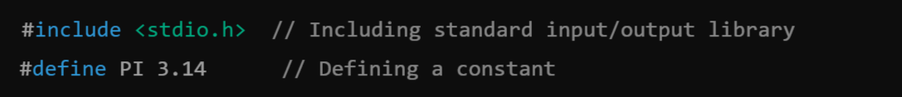
1. Preprocessor Directives:
These are used to include external files, libraries, or to define constants. Preprocessor directives start with #, and they are processed before the actual compilation of the code begins.
Example:
2. Global Declarations: This section is optional. If your program requires global variables or function declarations, they are declared here.
Example:

Slide 23
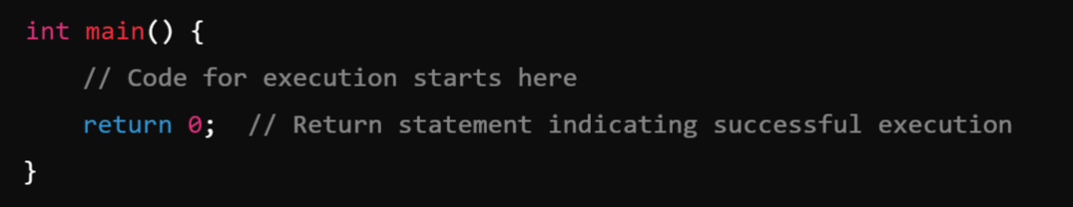
Main Function
The main() function is where the program starts executing. Every C program must have one main() function.
Note: In the C program, return 0; in the main function indicates that the program has successfully executed without any errors.
When the program reaches return 0;, it ends the main() function and sends the value 0 back to the operating system. This is known as the exit status of the program, which is typically used by the operating system or the calling process to determine whether the program ran successfully.
If you had return 1; instead of return 0;, it would indicate an error in the program. In such cases, the program might exit with a non-zero status to indicate a failure.

Slide 24
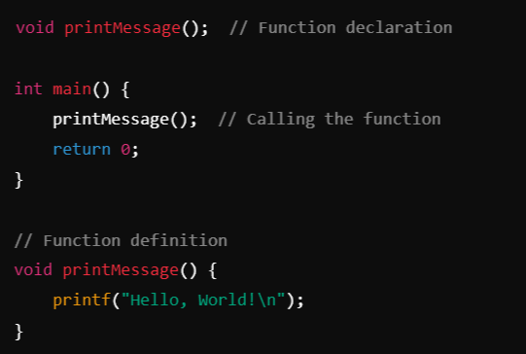
Function Declarations and Definitions:
Functions may be declared and defined either before or after main(). These are optional unless your program requires additional logic beyond the main() function.
Example:
Note:
In C, function declarations (also known as function prototypes) should be placed before the main() function or any other function that calls them. This ensures that the compiler knows about the function's signature (name, return type, and parameters) before it is used in the program.

Slide 25
Module-1: BASICS OF C PROGRAMMING :
Introduction to programming paradigms: Applications of C Language, Structure of C program
C programming: Data Types, Constants, Enumeration Constants, Keywords.
Operators: Precedence and Associativity, Expressions, Input/Output statements, Assignment statements, Decision making statements, Switch statement, Looping statements Preprocessor directives, Compilation process.

